Slide 1
Wave Velocity or Phase Velocity
When a monochromatic wave travels through a medium, its velocity of advancement in the medium is called the wave velocity or phase velocity (V_{p}).
where is the angular frequency
and is the wave number.

Slide 2
Wave velocity/phase velocity
Wave motion is a form of disturbance which travels through medium due to the repeated motion of the particles of the medium about their mean positions, the motion being handed over from one particle to the next.
Every particle begins its vibrations a little later than its predecessor and there is a progressive change of phase as wave travel from one particle to the next.
The phase relationship of these particles that we observe as a wave and the velocity with which the plane of equal phase travels through the medium, is known as phase velocity.
Hence the velocity with which monochromatic wave propagates through medium is called the wave velocity.
Dr. Kamalpreet Kaur

Slide 3
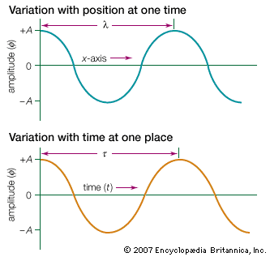
The equation of motion for a plane progressive wave is given by
y=A cos (wt - kx) ……………(1)
Where y= displacement of the wave depends upon space coordinate ‘x’ and time ‘t’. A is the amplitude and w is the angular frequency which is related to the frequency v by
w=2πv
k is the phase constant and given by k=2π/λ
Dr. Kamalpreet Kaur

Slide 4
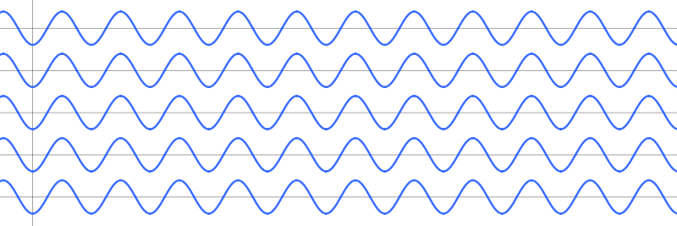
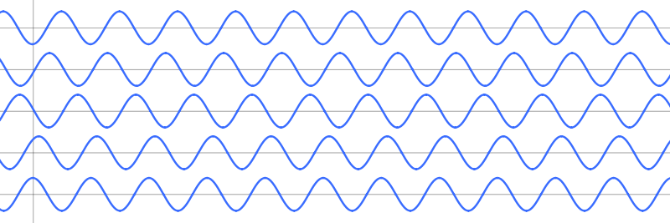
The argument of the cosine function represents the phase of the wave, ϕ, or the fraction of a complete cycle of the wave.
In-phase waves
Line of equal phase = wavefront = contours of maximum field
Out-of-phase waves
Dr. Kamalpreet Kaur

Slide 5
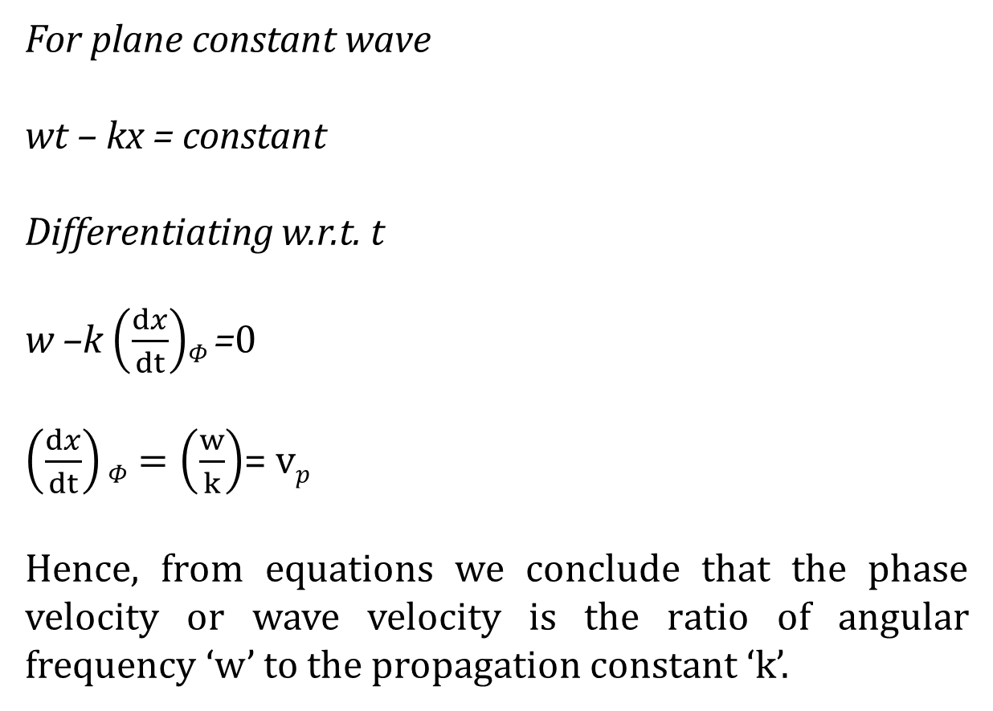
Dr. Kamalpreet Kaur

Slide 6
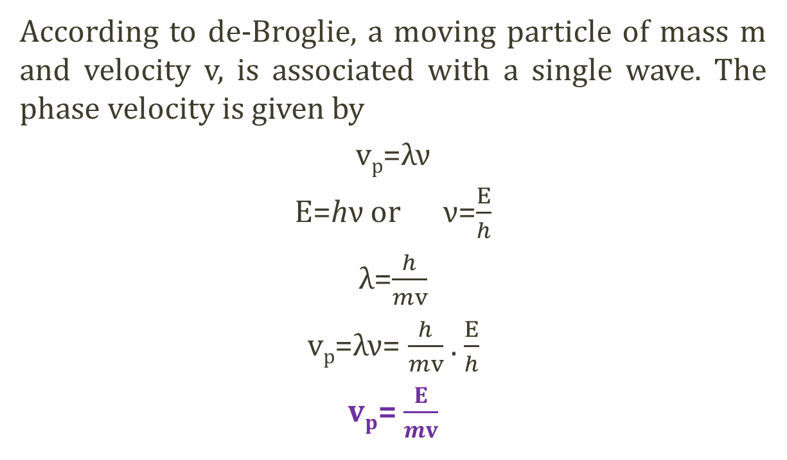
Phase velocity of de-Broglie waves exceeds velocity of light
Dr. Kamalpreet Kaur

Slide 7
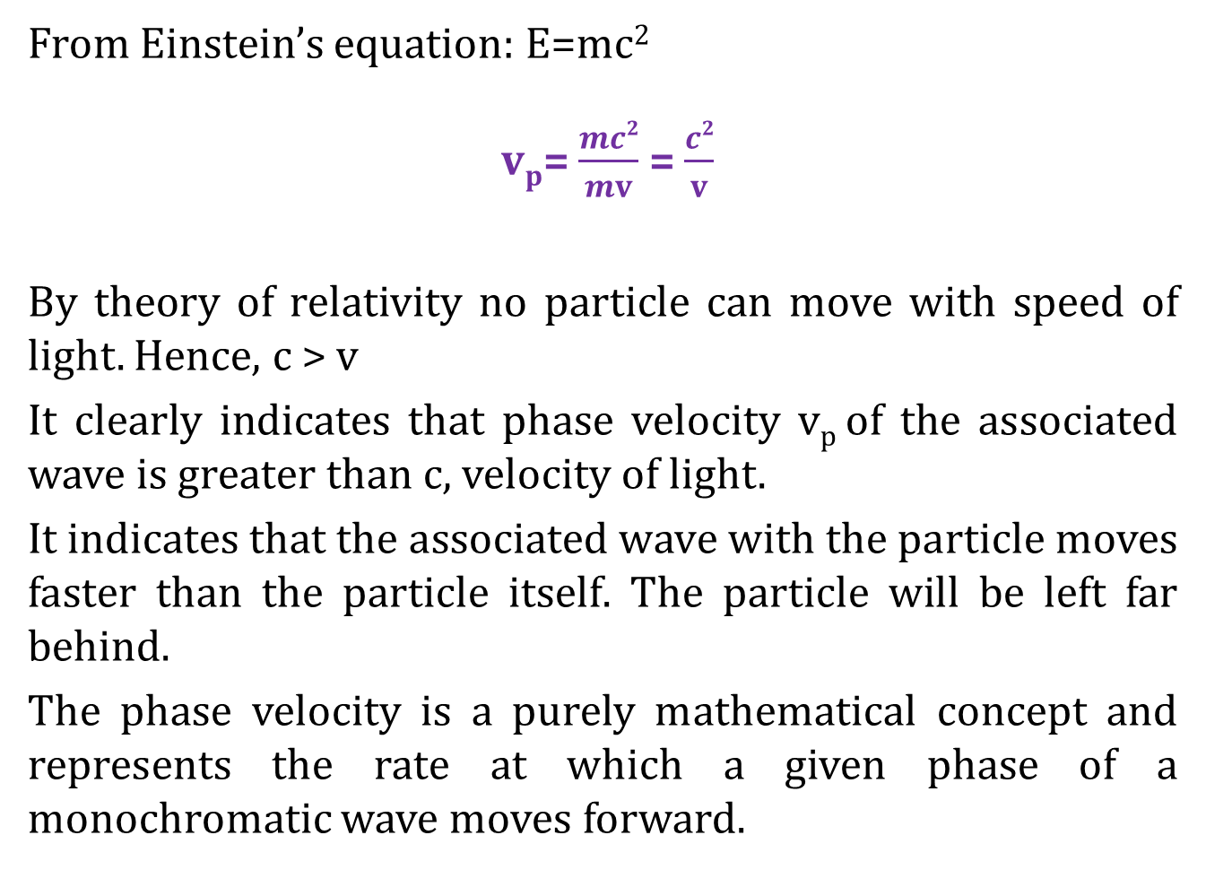
Dr. Kamalpreet Kaur

Slide 8
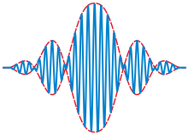
Group velocity: the concept of wave packet
The group velocity of a wave is the velocity with which the overall shape of the waves' amplitudes known as the modulation or envelope of the wave propagates through space.
For example, imagine what happens if a stone is thrown into the middle of a very still pond. When the stone hits the surface of the water, a circular pattern of waves appears. It soon turns into a circular ring of waves with a quiescent center. The ever expanding ring of waves is the wave group, within which one can discern individual wavelets of differing wavelengths traveling at different speeds. The longer waves travel faster than the group as a whole, but they die out as they approach the leading edge. The shorter waves travel more slowly and they die out as they emerge from the trailing boundary of the group.
Solid line: A wave packet. Dashed line: The envelope of the wave packet. The envelope moves at the group velocity.

Slide 9
The Group Velocity
This is the velocity at which the overall shape of the wave’s amplitudes, or the wave ‘envelope’, propagates. (= signal velocity)
Here, phase velocity = group velocity (the medium is non-dispersive)
Dr. Kamalpreet Kaur

Slide 10
Dispersion: phase/group velocity depends on frequency
Black dot moves at phase velocity. Red dot moves at group velocity.
This is normal dispersion (refractive index decreases with increasing λ)
Dr. Kamalpreet Kaur

Slide 11
Expression for group velocity and wave velocity
Let the wave packet is formed by the superimposition of two waves of equal amplitude ‘A’ but of slightly different frequency w and w+dw and propagation constants k and k+dk. Displacement y₁ and y₂ of two waves
y₁ = A cos(wt-kx)
y₂ = A cos[(w+dw)t - (k+dk)x]
The resultant displacement y= y₁+ y₂
y= A {cos(wt-kx)+cos[(w+dw)t - (k+dk)x]}
Dr. Kamalpreet Kaur

Slide 12
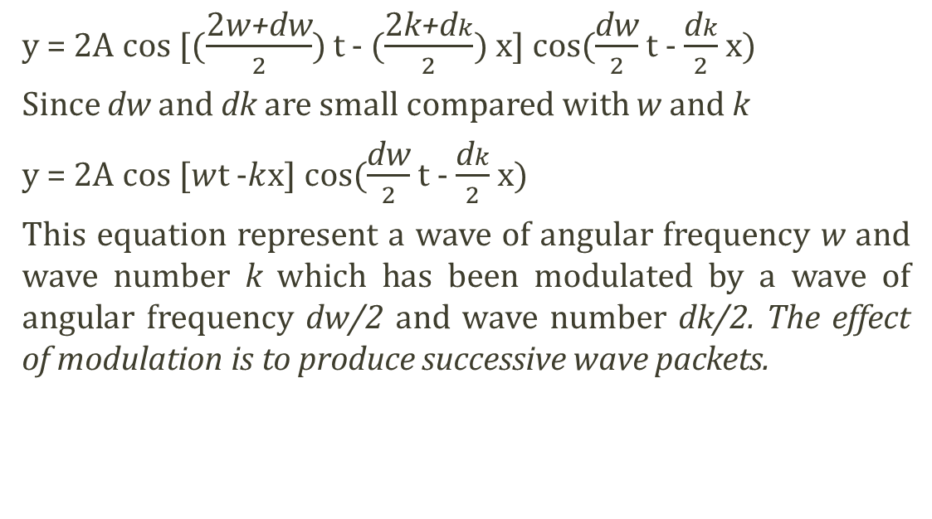
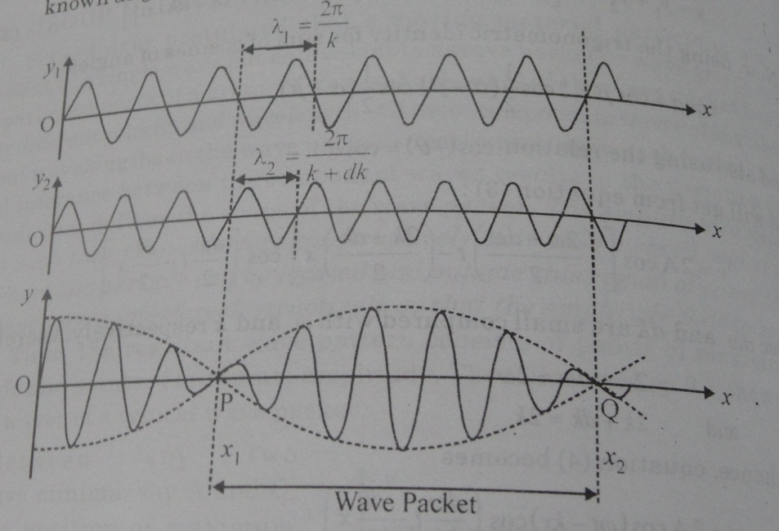
Wave packet produced by superimposition of two waves with slightly different frequency
Dr. Kamalpreet Kaur

Slide 13
Group Velocity
In practice, we came across pulses rather than monochromatic waves. A pulse consists of a number of waves differing slightly from one another in frequency.
The observed velocity is, however, the velocity with which the maximum amplitude of the group advances in a medium.
So, the group velocity is the velocity with which the energy in the group is transmitted (V_{g}).
The individual waves travel “inside” the group with their phase velocities.

Slide 14
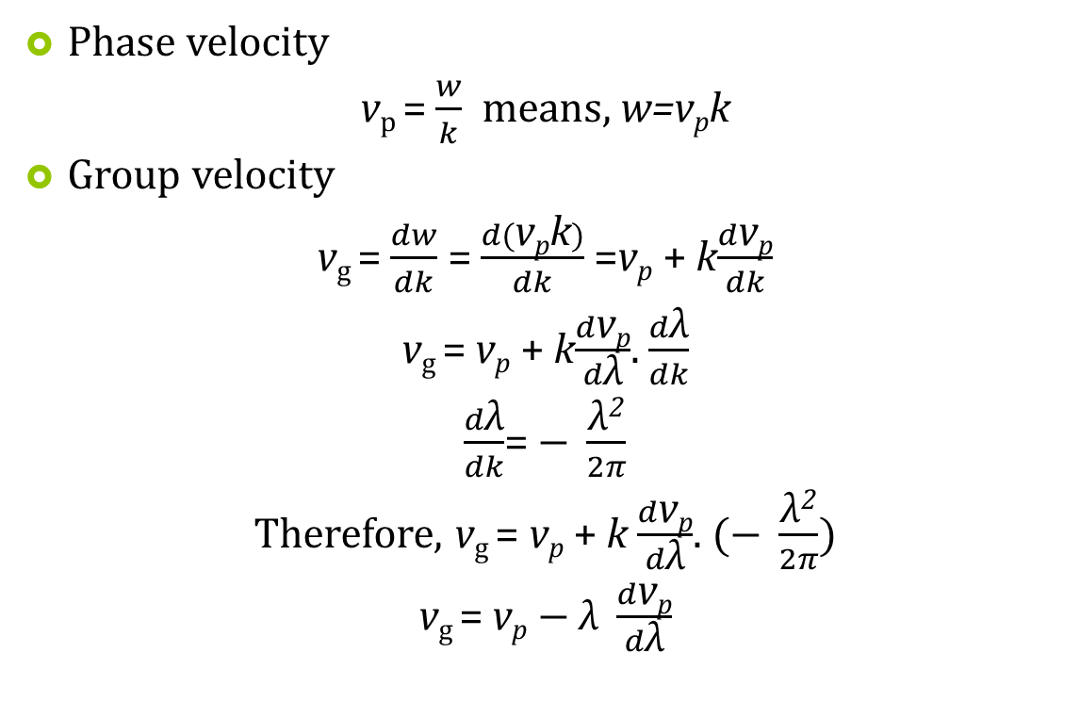
Relation between phase velocity and group velocity
Dr. Kamalpreet Kaur

Slide 15

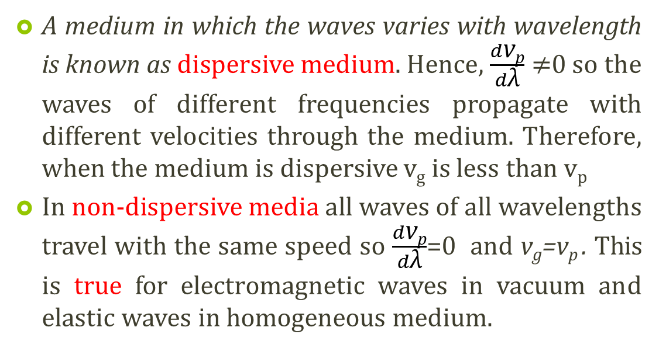
Dr. Kamalpreet Kaur

Slide 16
Group Velocity of De-Broglie’s waves
The discrepancy is resolved by postulating that a moving particle is associated with a “wave packet” or “wave group”, rather than a single wave-train.
A wave group having wavelength λ is composed of a number of component waves with slightly different wavelengths in the neighborhood of λ.
Suppose a particle of rest mass m_{o} moving with velocity v then associated matter wave will have
and
where

Slide 17
and
On differentiating w.r.t. velocity, v
(i)
(ii)

Slide 18
Dividing (i) by (ii)
Wave group associated with a moving particle also moves with the velocity of the particle.
Moving particle wave packet or wave group

Slide 19
Heisenberg Uncertainty Principle
It states that only one of the “position” or “momentum” can be measured accurately at a single moment within the instrumental limit.
or
It is impossible to measure both the position and momentum simultaneously with unlimited accuracy.
uncertainty in position
uncertainty in momentum
then
The product of & of an object is greater than or equal to

Slide 20
If is measured accurately i.e.
The principle applies to all canonically conjugate pairs of quantities in which measurement of one quantity affects the capacity to measure the other.
Like, energy E and time t.
and angular momentum L and angular position θ

Slide 21
Applications of Heisenberg Uncertainty Principle
(i) Non-existence of electron in nucleus
Order of diameter of a nucleus ~ 5 x10⁻¹⁵ m
If electron exist in the nucleus then
then
relativistic

Slide 22
Thus the kinetic energy of an electron must be greater than 20 MeV to be a part of nucleus
Experiments show that the electrons emitted by certain unstable nuclei don’t have energy greater than 3-4 MeV.
Thus we can conclude that the electrons cannot be present within nuclei.

Slide 23
Concept of Bohr Orbit violates Uncertainty Principle
But

Slide 24
According to the concept of Bohr orbit, energy of an electron in a orbit is constant i.e. ΔE = 0.
All energy states of the atom must have an infinite life-time.
But the excited states of the atom have life–time ~ 10⁻⁸ sec.
The finite life-time Δt gives a finite width (uncertainty) to the energy levels.
Assignment:
Zero point energy of Harmonic Oscillator
Finite width of spectral lines
Radius of Bohr’s first orbit

Slide 25
Radius of Bohr’s first orbit
Let are the uncertainty in position and momentum of electron in the first orbit. We know

Slide 26
Wave function
The quantity with which Quantum Mechanics is concerned is the wave function of a body.
Wave function, ψ is a quantity associated with a moving particle. It is a complex quantity.
|Ψ|² is proportional to the probability of finding a particle at a particular point at a particular time. It is the probability density.
ψ is the probability amplitude.
Thus if
then

Slide 27
Normalization
|Ψ|² is the probability density.
The probability of finding the particle within an element of volume
Since the particle is definitely be somewhere, so
Normalization
A wave function that obeys this equation is said to be normalized.

Slide 28
Properties of wave function
It must be finite everywhere.
If ψ is infinite for a particular point, it mean an infinite large probability of finding the particles at that point. This would violates the uncertainty principle.
2. It must be single valued.
If ψ has more than one value at any point, it mean more than one value of probability of finding the particle at that point which is obviously ridiculous.
3. It must be continuous and have a continuous first derivative everywhere.
must be continuous
4. It must be normalizable.

Slide 29
Schrodinger’s time independent wave equation
One dimensional wave equation for the waves associated with a moving particle is
(i)
where
ψ is the wave amplitude for a given x.
A is the maximum amplitude.
λ is the wavelength
From (i)
(ii)

Slide 30
where K is the K.E. for the non-relativistic case
Suppose E is the total energy of the particle
and V is the potential energy of the particle
(iii)

Slide 31
Equation (ii) now becomes
This is the time independent (steady state) Schrodinger’s wave equation for a particle of mass m_{o}, total energy E, potential energy V, moving along the x-axis.
If the particle is moving in 3-dimensional space then

Slide 32
This is the time independent (steady state) Schrodinger’s wave equation for a particle in 3-dimensional space.
For a free particle V = 0, so the Schrodinger equation for a free particle

Slide 33
Schrodinger’s time dependent wave equation
Wave equation for a free particle moving in +x direction is
(i)
where E is the total energy and p is the momentum of the particle
Differentiating (i) twice w.r.t. x
(ii)
Differentiating (i) w.r.t. t
(iii)

Slide 34
For non-relativistic case
E = K.E. + Potential Energy
(iv)
Using (ii) and (iii) in (iv)
This is the time dependent Schrodinger’s wave equation for a particle in one dimension.

Slide 35
Linearity and Superposition
If ψ₁ and ψ₂ are two solutions of any Schrodinger equation of a system, then linear combination of ψ₁ and ψ₂ will also be a solution of the equation..
is also a solution
Here are constants
Above equation suggests:
(i) The linear property of Schrodinger equation
(ii) ψ₁ and ψ₂ follow the superposition principle

Slide 36
If P₁ is the probability density corresponding to ψ₁ and P₂ is the probability density corresponding to ψ₂
Then
due to superposition principle
Total probability will be
Probability density can’t be added linearly

Slide 37
Expectation values
Expectation value of any quantity which is a function of ‘x’ ,say f(x) is given by
for normalized ψ
Thus expectation value for position ‘x’ is
Expectation value is the value of ‘x’ we would obtain if we measured the positions of a large number of particles described by the same function at some instant ‘t’ and then averaged the results.

Slide 38
Q. Find the expectation value of position of a particle having wave function ψ = ax between x = 0 & 1, ψ = 0 elsewhere.
Solution

Slide 39
Operators
(Another way of finding the expectation value)
An operator is a rule by means of which, from a given function we can find another function.
For a free particle
Then
Here
(i)
is called the momentum operator

Slide 40
Similarly
Here
(ii)
is called the Total Energy operator
Equation (i) and (ii) are general results and their validity is the same as that of the Schrodinger equation.

Slide 41
If a particle is not free then
This is the time dependent Schrodinger equation

Slide 42
If Operator is Hamiltonian
Then time dependent Schrodinger equation can be written as
This is time dependent Schrodinger equation in Hamiltonian form.

Slide 43
Eigen values and Eigen function
Schrodinger equation can be solved for some specific values of energy i.e. Energy Quantization.
The energy values for which Schrodinger equation can be solved are called ‘Eigen values’ and the corresponding wave function are called ‘Eigen function’.
Suppose a wave function (ψ) is operated by an operator ‘α’ such that the result is the product of a constant say ‘a’ and the wave function itself i.e.
then
ψ is the eigen function of
a is the eigen value of

Slide 44
Q. Suppose is eigen function of operator then find the eigen value.
Solution.
The eigen value is 4.

Slide 45
Particle in a Box
Consider a particle of rest mass m_{o} enclosed in a one-dimensional box (infinite potential well).
Boundary conditions for Potential
{
0 for 0 < x < L
V(x)=
particle
for 0 > x > L
Boundary conditions for ψ
{
0 for x = 0
x = 0
x = L
Ψ =
0 for x = L
Thus for a particle inside the box Schrodinger equation is
(i)
inside

Slide 46
(k is the propagation constant)
(ii)
Equation (i) becomes
(iii)
General solution of equation (iii) is
(iv)

Slide 47
Boundary condition says ψ = 0 when x = 0
Equation (iv) reduces to
(v)
Boundary condition says ψ = 0 when x = L

Slide 48
(vi)
Put this in Equation (v)
Where n # 0 i.e. n = 1, 2, 3…., because n=0 gives ψ = 0 everywhere.
Put value of k from (vi) in (ii)

Slide 49
(vii)
Where n = 1, 2, 3….
Equation (vii) concludes
1. Energy of the particle inside the box can’t be equal to zero.
The minimum energy of the particle is obtained for n = 1
(Zero Point Energy)
If momentum i.e.
But since the particle is confined in the box of dimension L.

Slide 50
Thus zero value of zero point energy violates the Heisenberg’s uncertainty principle and hence zero value is not acceptable.
2. All the energy values are not possible for a particle in
potential well.
Energy is Quantized
3. E_{n} are the eigen values and ‘n’ is the quantum number.
4. Energy levels (E_{n}) are not equally spaced.
n = 3
n = 2
n = 1

Slide 51
Using Normalization condition
The normalized eigen function of the particle are

Slide 52
Probability density figure suggest that:
1. There are some positions (nodes) in the box that will never be occupied by the particle.
2. For different energy levels the points of maximum probability are found at different positions in the box.
|ψ₁|² is maximum at L/2 (middle of the box)
|ψ₂|² is zero L/2.

Slide 53
Particle in a Three Dimensional Box
Eigen energy
Eigen function

